Slide 1
WELCOME

Slide 2
ONLINE BOOK STORE
Presentation Dnyandip Nehete

Slide 3
TABLE OF CONTENTS
01
02
03
04
05
06
INTODUCTION
OBJECTIVES
SCOPE OF THE PROJECT
DFD DIAGRAMS
ERD
DIAGRAM
TECHNOLOGY REQUIREMENTS
0
09
07
08
08
CONCLUSION
DATABASE DESIGN
PROJECT SCREENSHOT

Slide 4

INTRODUCTION
An online bookstore software projects that acts as a central database containing various books in stock along with their title, author, and cost.
This project is a website that acts as a central bookstore.
This web project is developed using PHP as the front end and SQL as a back-end.
The SQL database stores various book related details. A user visiting the website can see a wide range of books arranged in respective categories.
The user may select desired book and view its price. The user may even search for specific books on the website. Once the user selects a book, he then has to fill in a form and the book is booked for the user

Slide 5
INTRODUCTION
Key Points:
Online book store integrates modern technologies:
HTML
CSS
JavaScript
php
mysql

Slide 6
OBJECTIVES
There are certain objectives when it comes to Online Book Store :
The main objective of “Online Book Store” is to provide an essence of online book store via a simple and yet powerful medium.
The project has been designed to simulate the working of an actual online book store
The general objective is to make information necessary, quick, inexpensive, and flexible for the user.

Slide 7
SCOPE OF THE PROJECT
The main scope and deliverables of the project would be to:
Understand and prepare detailed requirement and specifications.
Prepare high level and detailed design specifications of the system.
Develop the system and coding.
Perform unit testing, integration, and system testing.
Demonstrate a bug free application after suitable modification if needed

Slide 8
TECHNOLOGY REQUIREMENT
Front-End:
HTML: Structure the platform's content.
CSS: Style and customize the design.
JavaScript: Add interactivity and dynamic behavior.
Back-End:
PHP: Handle server operations and processing.
MySQL: Store, update and manage platform data.
Testing:
Apache.

Slide 9
DFD DIAGRAM
Books & other details
Order receipt & confirmation
Admin
Online Book Store
User
Order & reports
Personal Details & Select product.
Fig: 1 CONTEXT DIAGRAM

Slide 10
DFD DIAGRAM
Admin
Status
Data
1.0
Administraction Process
Store
Access
process
Book
Order
Fig 2: DFD for Admin Process

Slide 11
DFD DIAGRAM
Enter data.
User
Registration Process
2.0
User Details
Register
status
Fig:3 DFD For User Registration

Slide 12
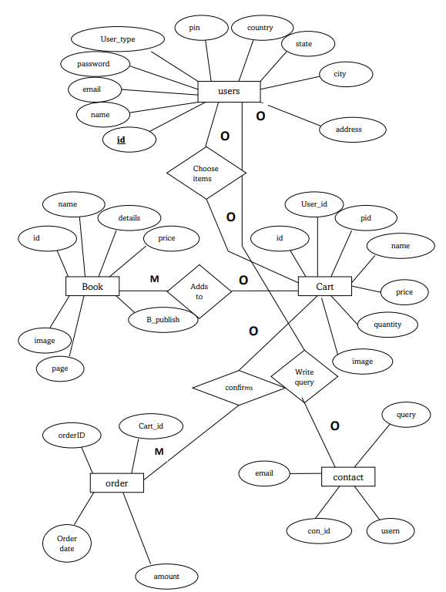
ERD DIAGRAM

Slide 13


USE CASE DIAGRAM
Admin
User
Register
Login
Login
Add or Book
Update
profile
Place order
Manage Order
User
Update cart
Admin
Add or Delete
View cart
Logout
Logout

Slide 14
DATABASE DESIGN
User Table
# | NAME | TYPE
1 | id | Int(100)
2 | Name | Varchar(100)
3 | Email | Varchar(100)
4 | Password | Varchar(100)
5 | User_type | Varchar(20)

Slide 15
DATABASE DESIGN
Placed Order Table
# | NAME | TYPE
1 | id | Int(100)
2 | User_id | Int(100)
3 | Name | Varchar(100)
4 | Number | Varchar(100)
5 | Email | Varchar(20)
6 | Method | Varchar(50)
7 | address | Varchar(500)
8 | Total_product | Varchar(1000)
9 | Total_price | Int(100)
10 | Placed_on | Varchar(50)
 | Payment_status | Varchar(20)

Slide 16
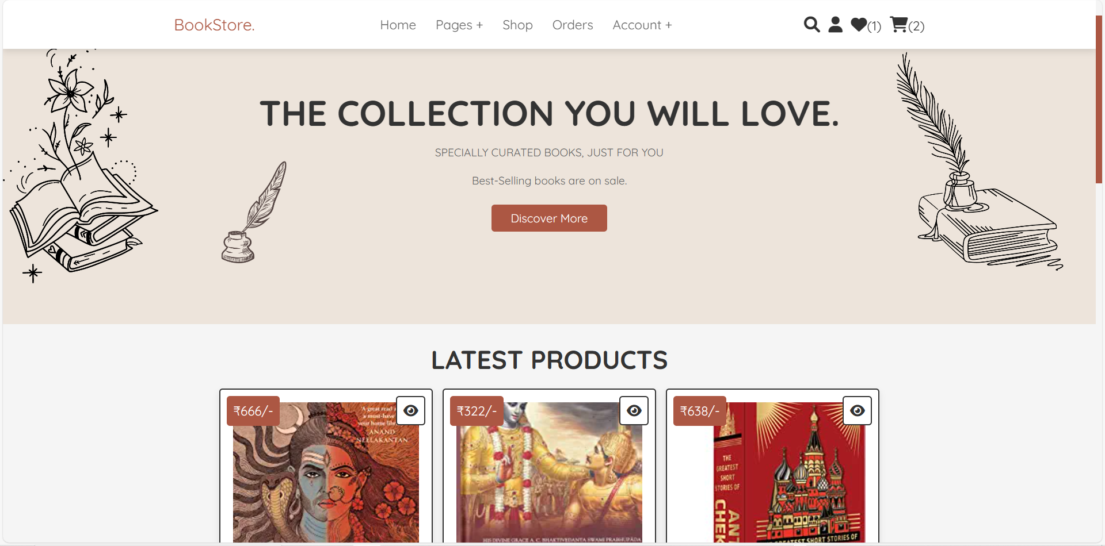
PROJECT SCREENSHOT
User Panel

Slide 17
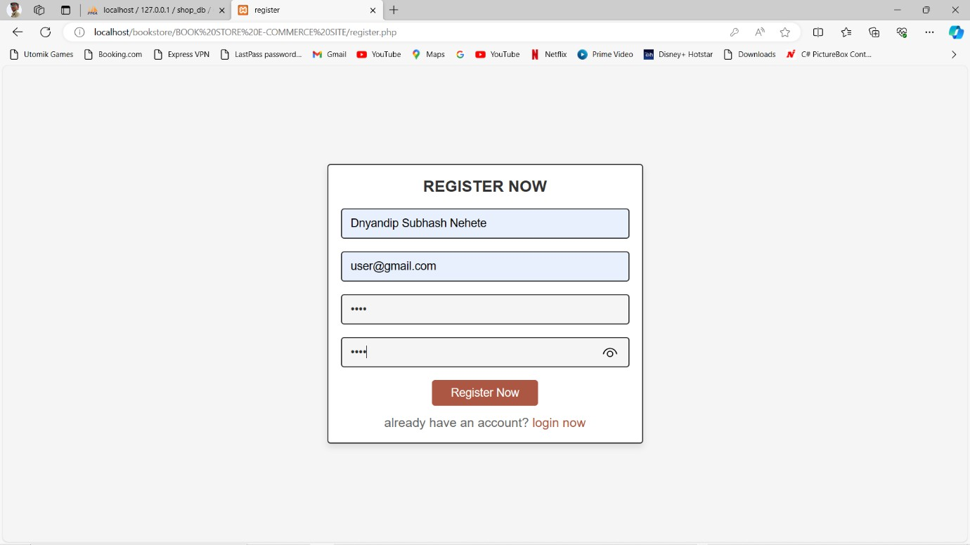
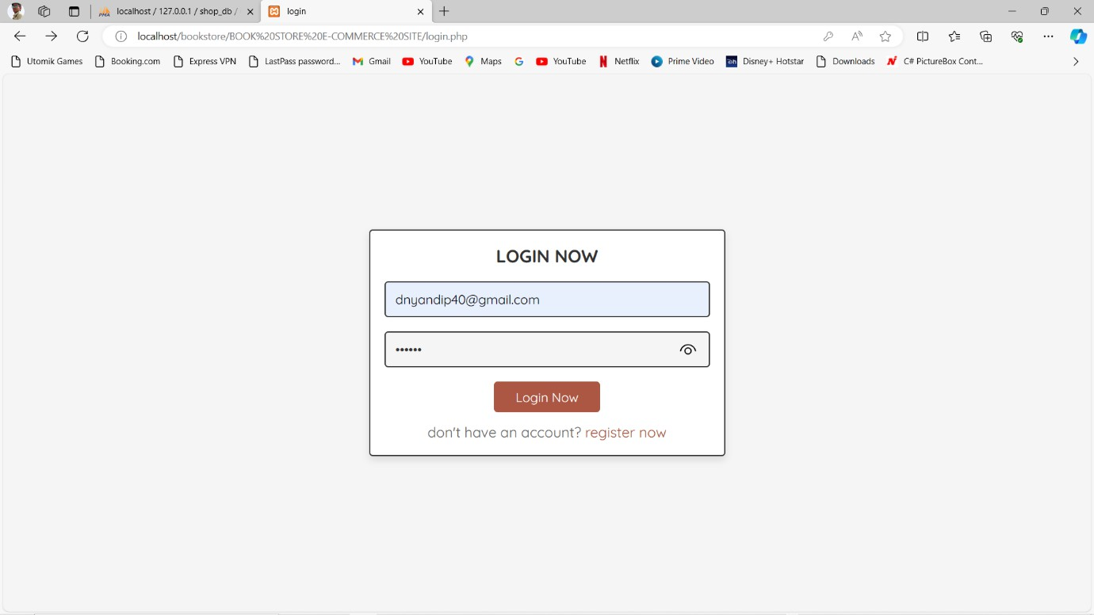
PROJECT SCREENSHOT
Registration Page
Login Page

Slide 18
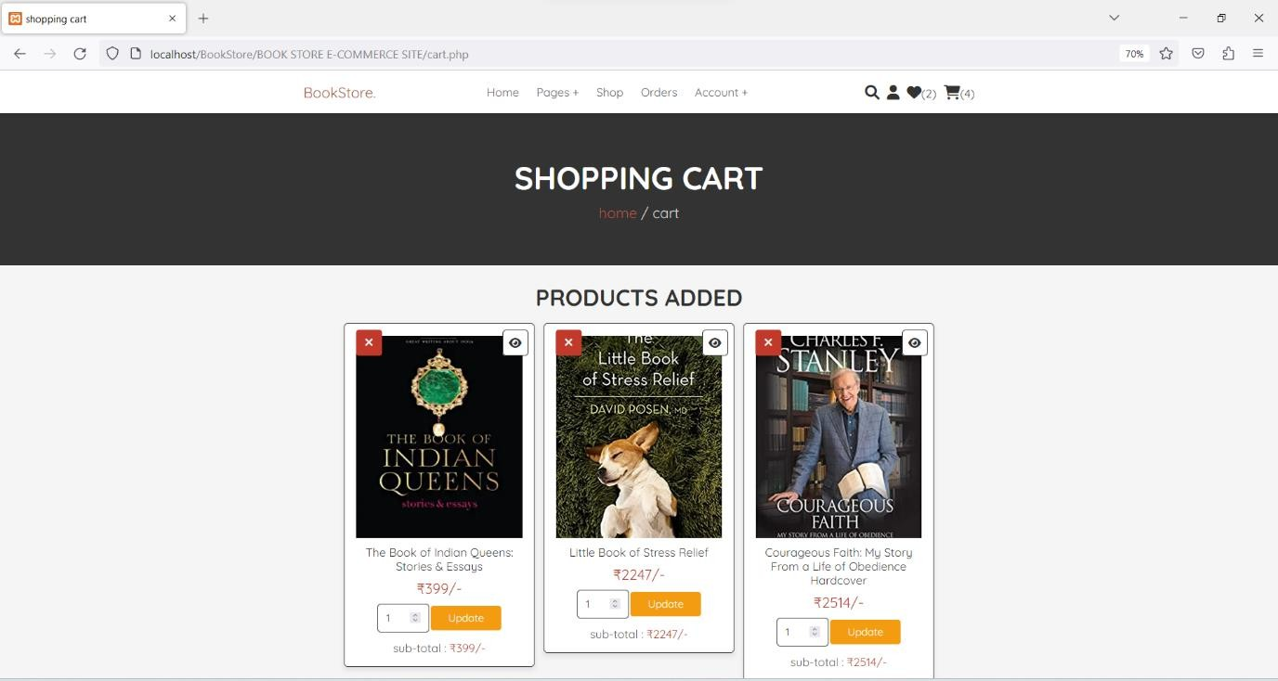
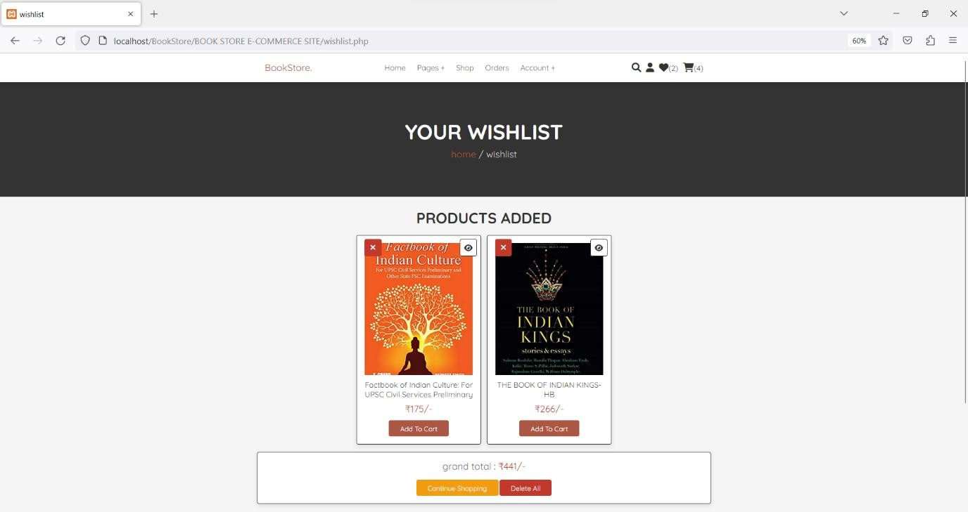
PROJECT SCREENSHOT
Shopping Cart
Your Wishlist

Slide 19
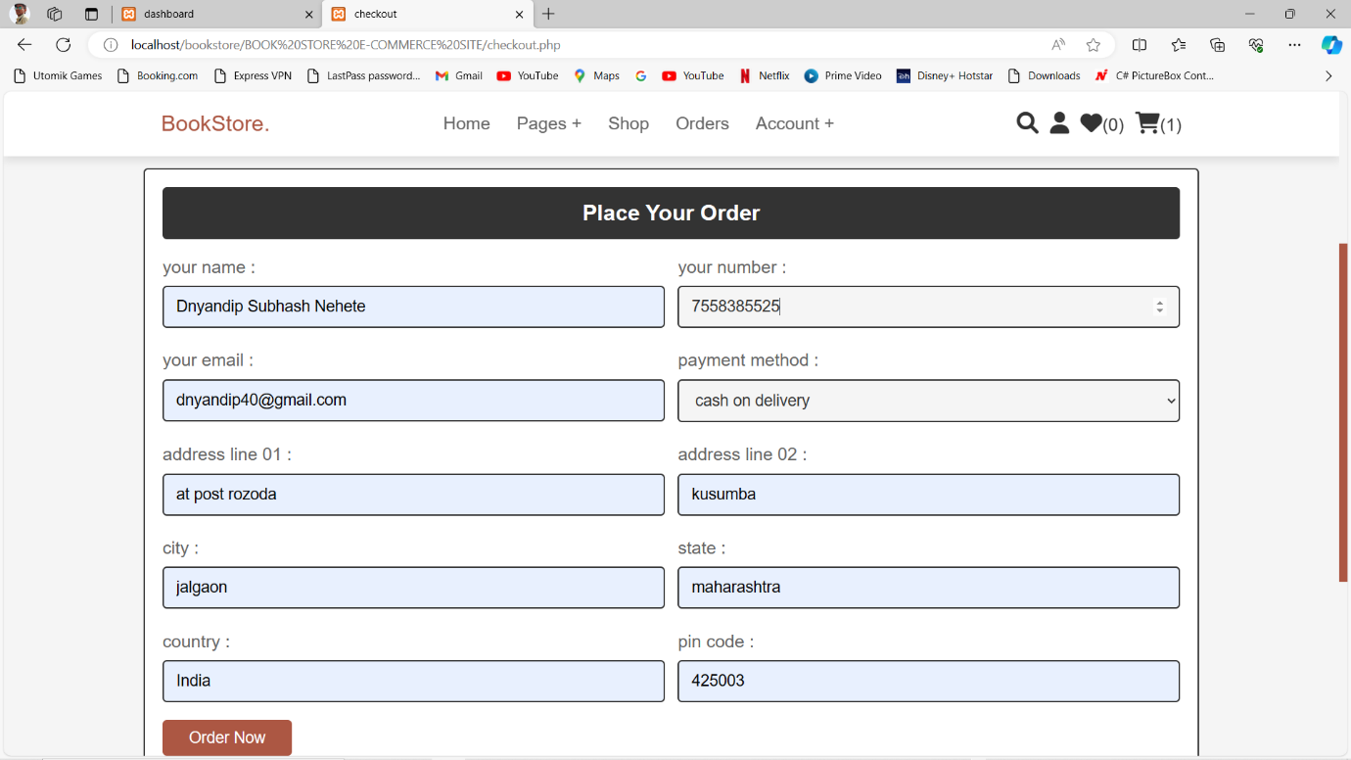
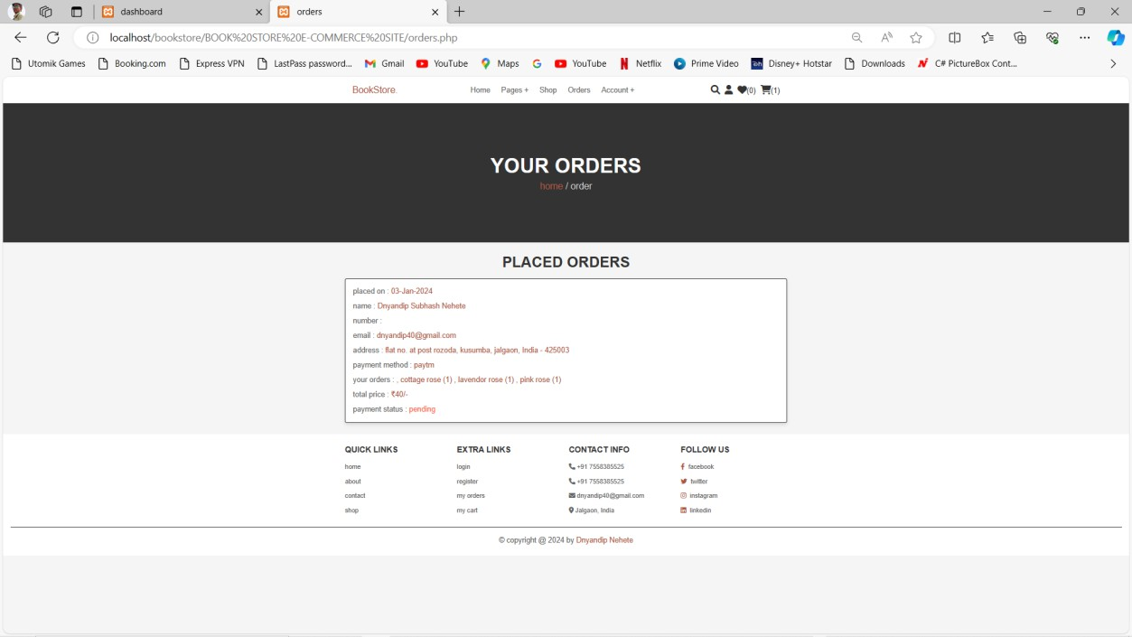
PROJECT SCREENSHOT
Place Order
Your Order

Slide 20
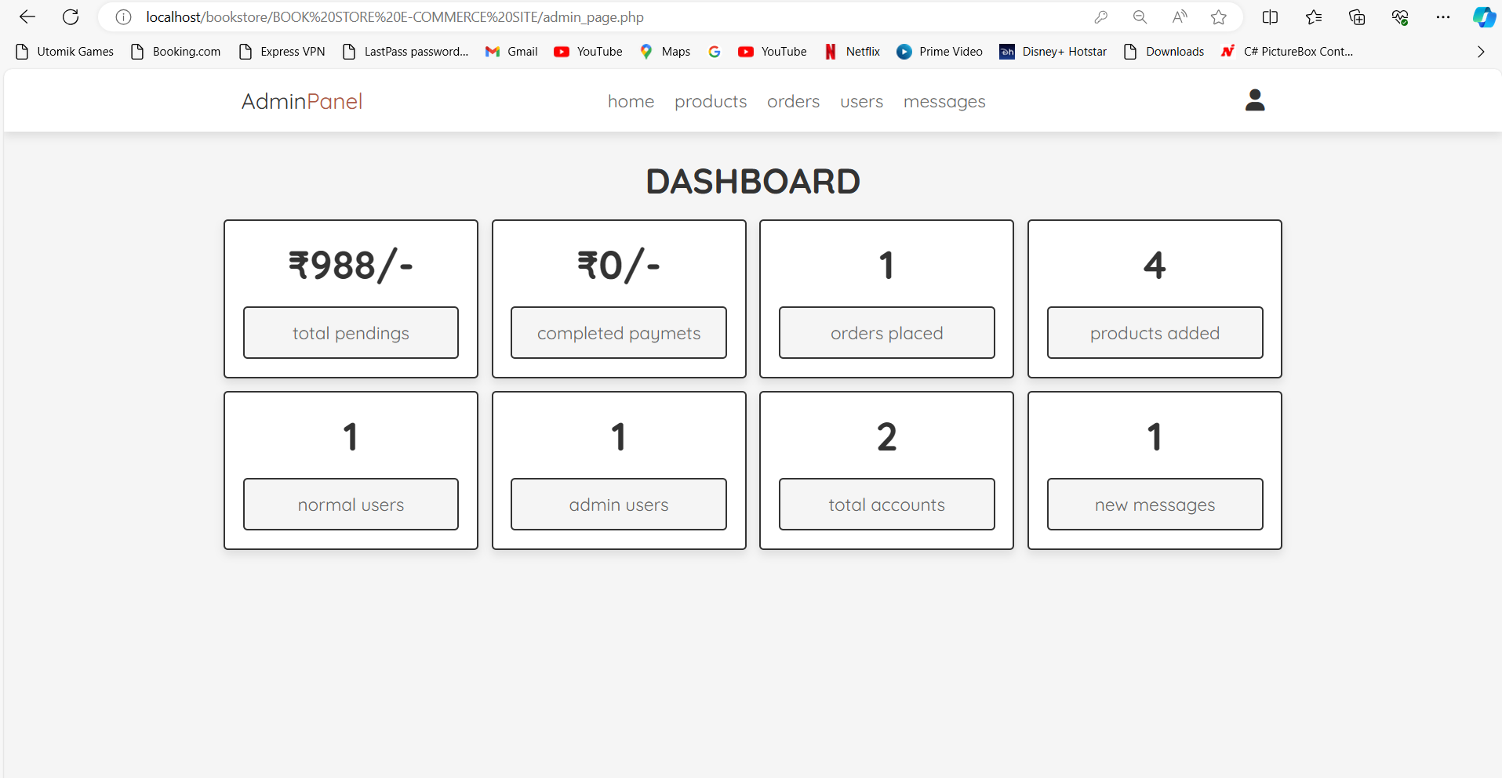
PROJECT SCREENSHOT
Admin panel

Slide 21
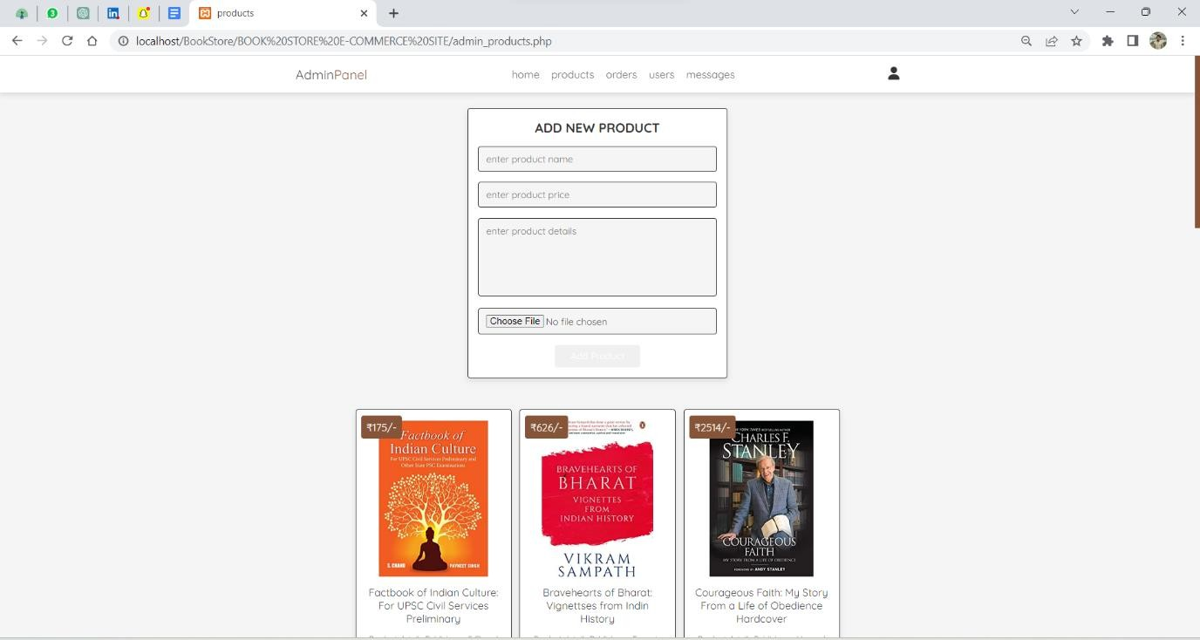
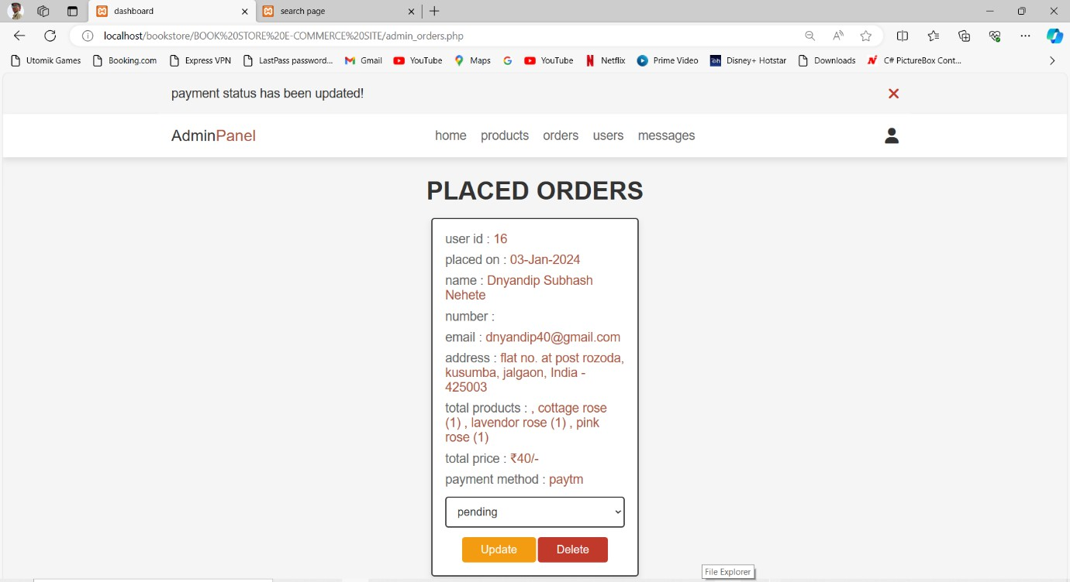
PROJECT SCREENSHOT

Slide 22
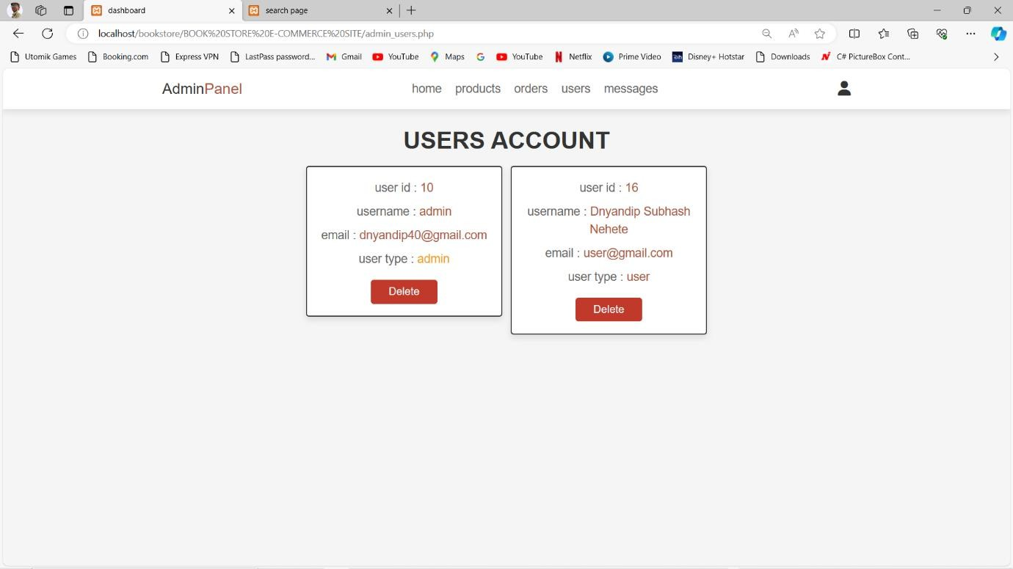
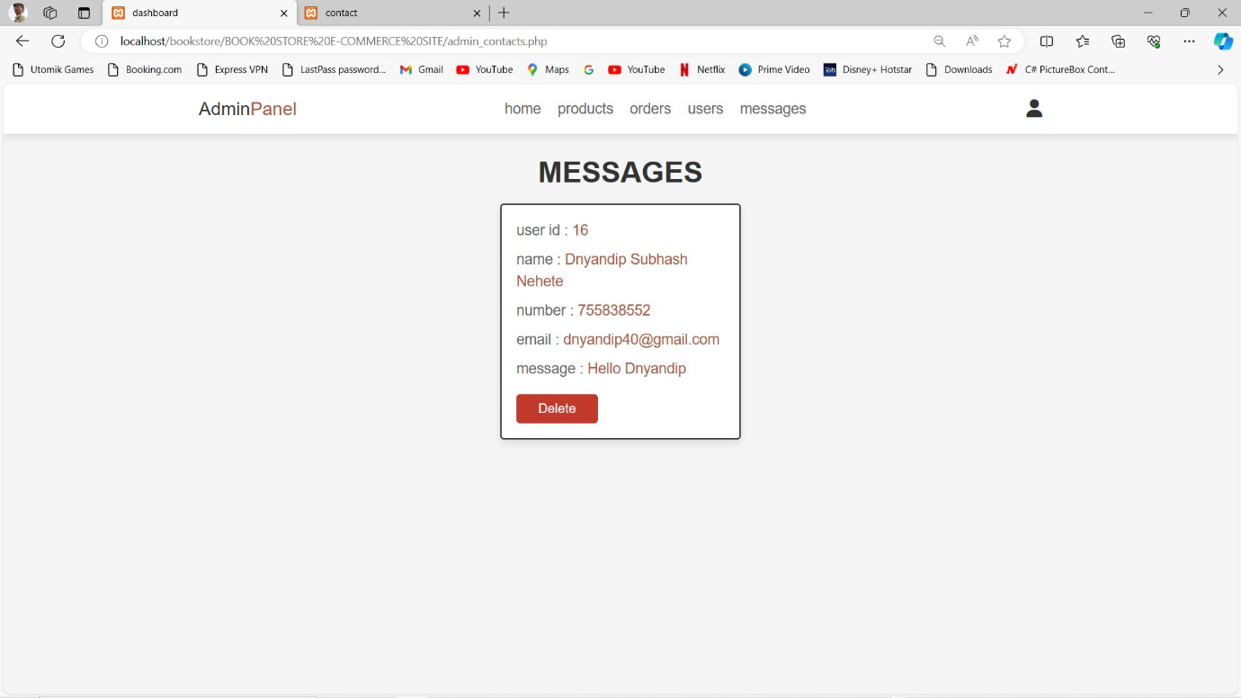
PROJECT SCREENSHOT

Slide 23
CONCLUSION
Online bookstore has many advantages compared to its counterparts such as physical book store, the online bookstore allows it's user to shop at one place where in physical store the books are scattered at the different places which consumes a lot of time and online bookstore helps in saving that time and it also avoids the problem of unavailability of books at physical store as numerous vendors from different places sell their books at one place.

Slide 24
THANK YOU!

Slide 25
THANK YOU!

